Slide 1
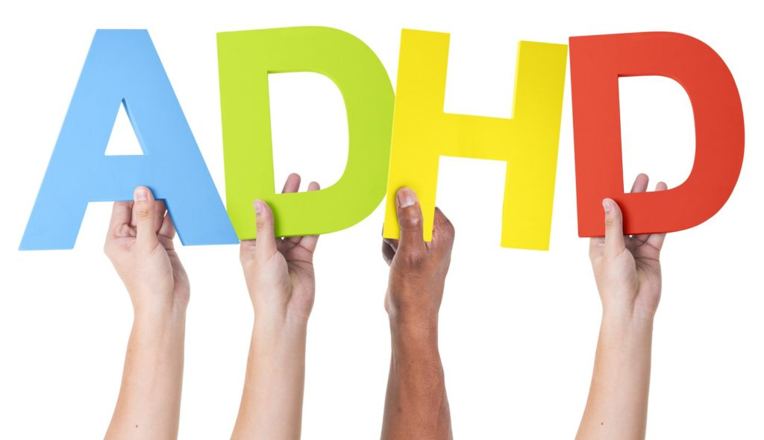
ADHD Assessment and Mis-diagnosis considerations.
Clinical Assessments, Scales, and Heritability

Slide 2
Definitions
Scales/Screeners:
Assessments:
Interviews and structured clinical assessments:
Researched tests:
Behavioral observations:
Heritability:
Self Diagnosis:
Mis-Diagnosis issues:

Slide 3
Thinking about the problem
ADHD is a complex, brain-based, neurodevelopmental disorder likely arising from the interplay of numerous social, developmental, environmental, and genetic risk factors

Slide 4
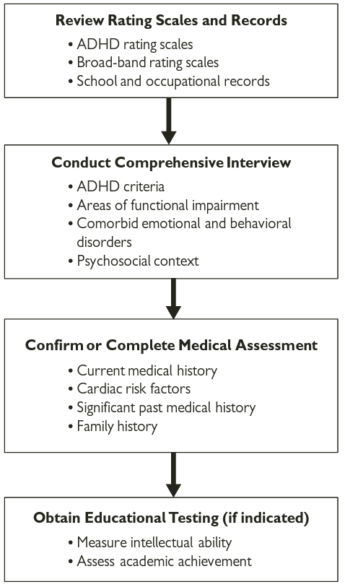
Steps to Diagnose
Scales/Screeners and interviews must be completed with evidence completed over time outside of other influences across different settings (outside medications or drugs.)

Slide 5
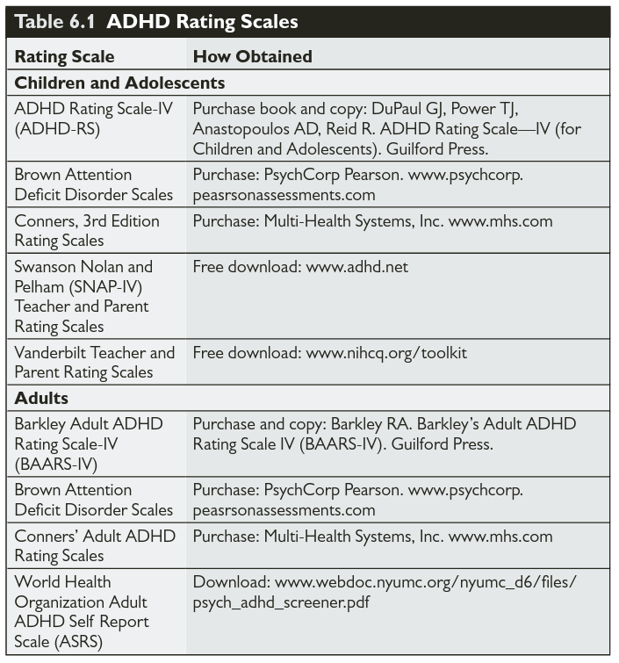
Screeners
Scales/Screeners: These a quick (less than 5 minute) screeners intended to identify symptoms (not syndrome). Scientifically validated scales go through significant scrutiny and study costing large amounts to validate.

Slide 6
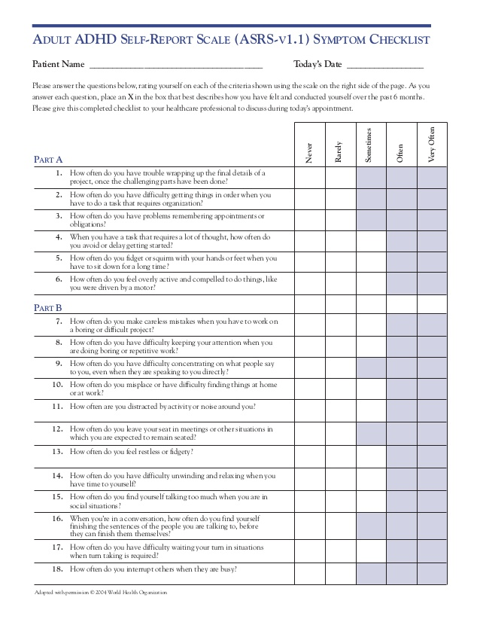
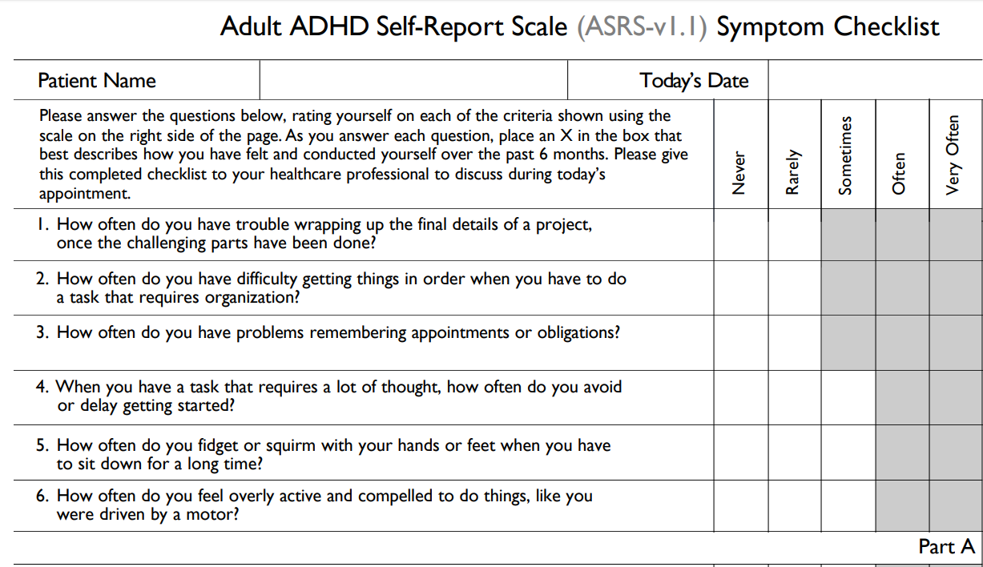
Screeners This one is split into Two sections based off of symptoms. Greyed area meet a “clinical cut off”

Slide 7
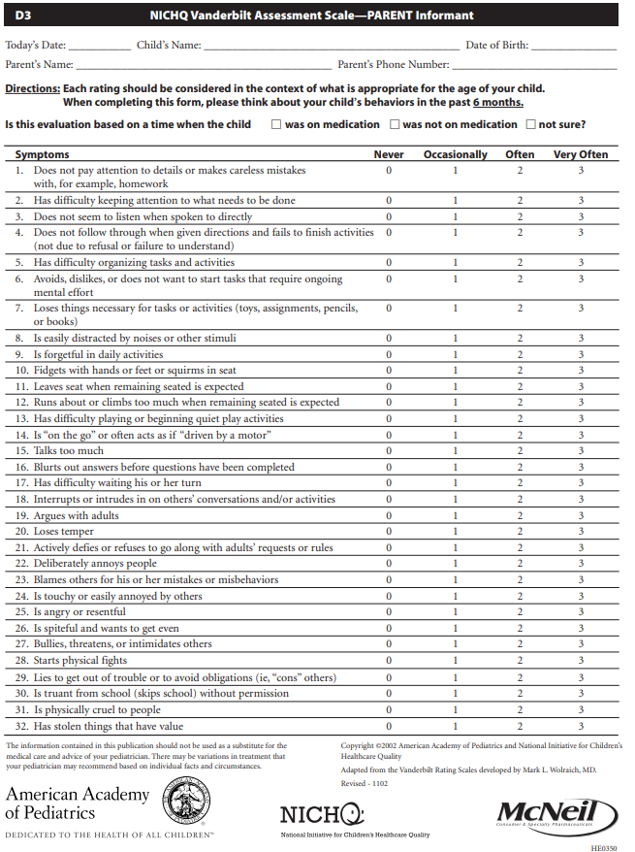
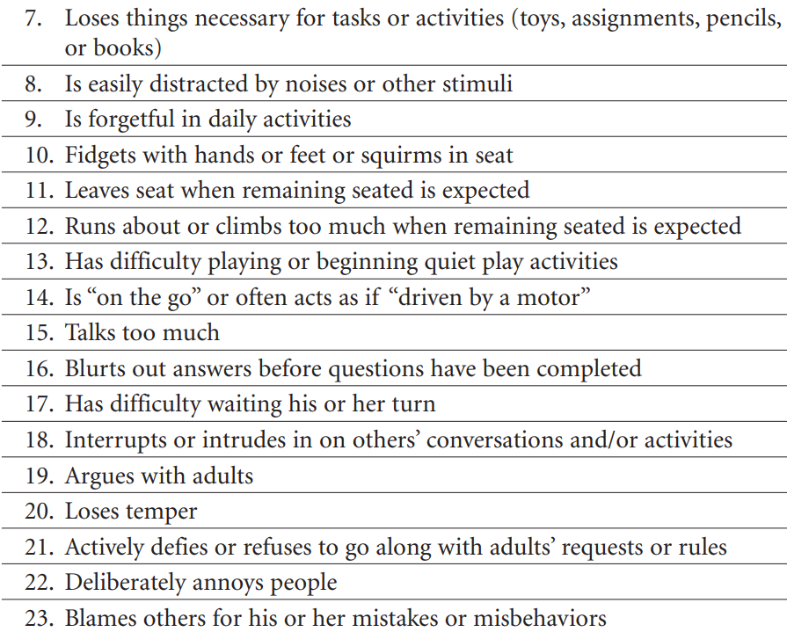
Screeners Vanderbilts: In order to avoid confirmation bias always assume you are wrong and disprove that you are wrong. (e.g. Ask questions that “prove” the symptoms are not accounted for by something else.)

Slide 8
Interviews and Assessments
Assessments: Structured interviews take considerable clinical training and effort. Minimally, clinicians must methodically determine the presence or absence of each DSM ADHD symptom and its approximate age of onset. Symptoms must be assessed in their developmental context; that is, they must be of greater frequency and severity than what is typical for others of the same sex, age, and cognitive level.

Slide 9
Interviews and Assessments
Assessments: The primary goal of the assessment is not to diagnose it is to disprove any other possibilities for the symptoms except for the diagnosis of ADHD.
The most difficult part can be, with children, finding if the behaviors occur in different settings (school, peers, home, or the community).
If diagnostic criteria existed, at what point did it meet “clinical significance?” – When it causes impairment.

Slide 10
Other “tests” and current research
Interviews and structured clinical assessments: There is no scientific justification for claiming to diagnose ADHD on the basis of other laboratory studies, computerized tests of attention, electroencephalography (EEG), or other brain imaging methods.
These studies are typically validated through completing structured interviews, which are the “gold standard” of ADHD assessment.

Slide 11
Other “tests” and current research
N-Back test is one cognitive assessment that has been research as part of determining how working memory works and as so far been determined it can only study that aspect which may or may not, depending on the case, be impacted by the syndrome of ADHD.
https://www.psytoolkit.org/experiment-library/nback.html

Slide 12
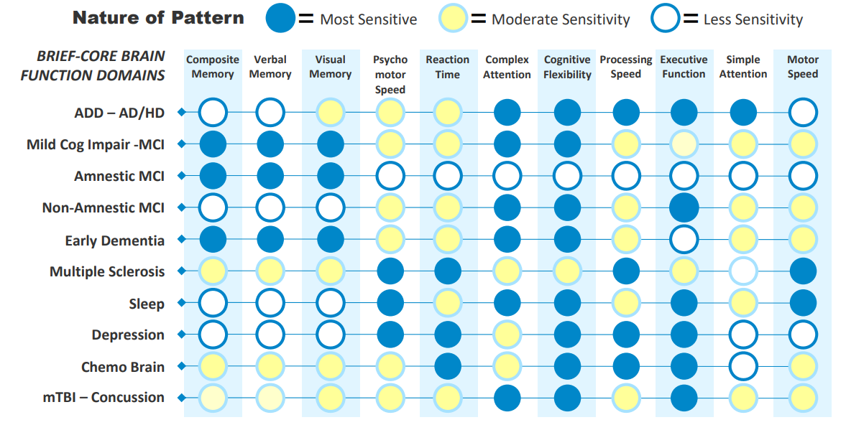
Other “tests” and current research
Interviews and structured clinical assessments: There is no scientific justification for claiming to diagnose ADHD on the basis of other laboratory studies, computerized tests of attention, electroencephalography (EEG), or other brain imaging methods.

Slide 13
Behavioral Observations
This is further looking at behavior related to ADHD as well as behavior outside of ADHD (trying to prove the behavior could be accounted for by other factors). Typically, this is done in school settings by trained school psychologists to also see accommodations, if any, are needed to improve learning or functioning.

Slide 14
Heritability
Some research says that up to 75% of the probability of being having a diagnosis has to do with genetics.

Slide 15
Heritability
Although diagnosis is strongly linked with genetics (even more than environment) subtype of ADHD (inattentive, Hyperactive/impulsive, or combined) is not.
Simply using a genetic test is not enough. Simply having the genes (expressed or not expressed) does not seem to determine symptoms.
Reminder: Simply having the symptoms is not enough for a diagnosis. The symptoms also must be causing functional impairment to the point of “clinical significance” (e.g. the point that the symptoms will not resolve themselves on their own through regular development or time because the symptoms hinder the person’s ability to overcome them.)

Slide 16
Heritability
Genetics is heavily pointed at by the fact that boys are more diagnosed than girls.
https://youtu.be/9ZUaDIxHqT4?t=71
Attention-Deficit/Hyperactivity Disorder (ADHD) – Pediatrics | Lecturio 2018 March 14th
Start at 1:11

Slide 17
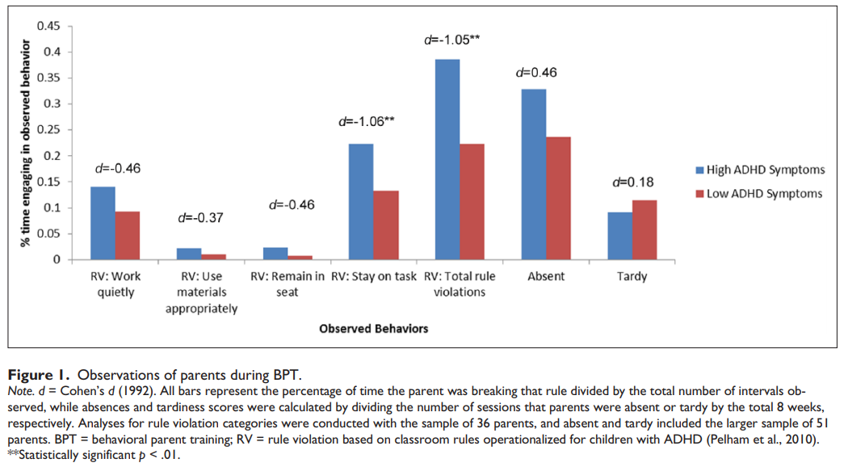
Heritability: considerations for treatment

Slide 18
Mis-diagnosis
Mis-diagnosis can result from traumatic stress or incident that the client does not disclose because of anxiety about talking about the traumatic event or poor rapport with the assessor.
Misinformation on diagnosis from others who are contributing information (teachers, parents, or others)
Intentional or unintentional misdirection or misinformation from others in order to pacify themselves (“I don’t want this kid in my classroom.” or “I just can’t believe he would be intentionally hurting their sibling/peer like that.”)

Slide 19
Self-Diagnosis: Discussion #3
You cannot self diagnose yourself with ADHD.
Why?

