Slide 1
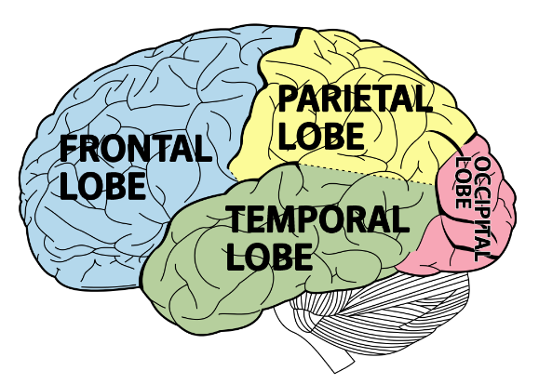
ADHD Co-Morbidity and Differential Diagnosis
Overlapping disorders and incongruent disorders

Slide 2
Definitions
Co-morbidity: the simultaneous presence of two chronic diseases or conditions in a patient. (One diagnosis is present along with another different diagnosis. E.g. you can have the flu and a broken foot.)
Differential Diagnosis: the process of differentiating between two or more conditions which share similar signs or symptoms. (Things that may look the same in a person but upon closer look you find separation in symptoms. E.g. you can have a flu and a cold separately at the same time but you may only catch one or mistake the flu for ‘just a bad cold’ at first).

Slide 3
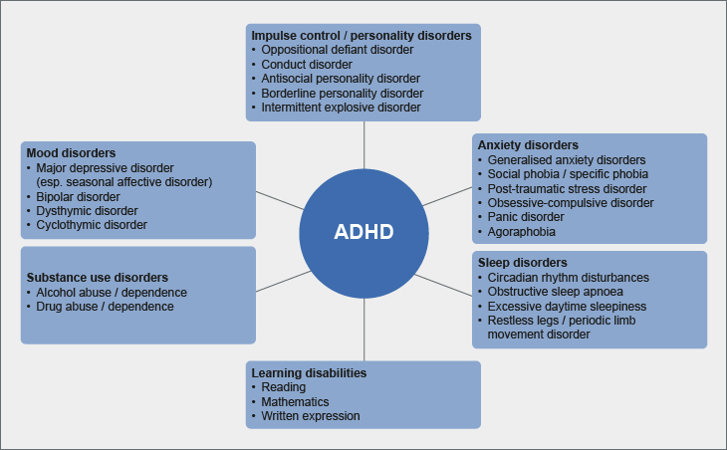
For Children:

Slide 4
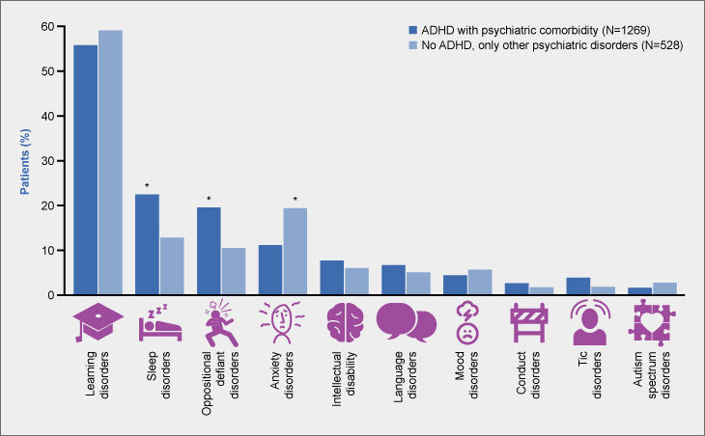
ADHD: They had ADHD and 1 or more comorbidity.
No ADHD: They had other co-morbidities but ADHD was not one of the other disorders.

Slide 5
Co-Morbidity: ODD, CD, and ASD
Co-morbidity: About one third of children with ADHD also have an anxiety disorder while up to one half of adults may.
The most common co-morbid diagnosis is a behavior oppositional defiant (ODD) and conduct disorder (CD) sometimes call disruptive behavior disorders (DBD)
The DSM-5 made changes for Autism Spectrum Disorder (ASD) and ADHD so that they can be co-occurring (both diagnosed at the same time) while research is unclear of how often there is a co-occurrence. One piece of research from 2013 suggests it may be between 16-2% of those with ASD may also have ADHD.

Slide 6
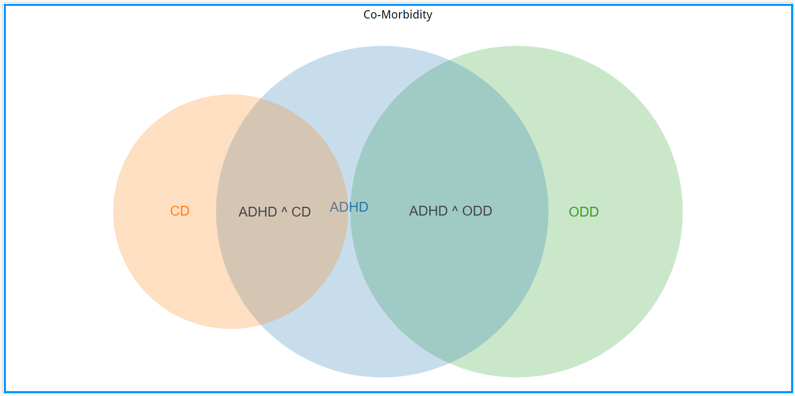
Definitions
For Children:
5-10% prevalence
Co-morbidity:
5-10% prevalence
2.5-5% prevalence
50%
50%
25-50%
50%
50%

Slide 7
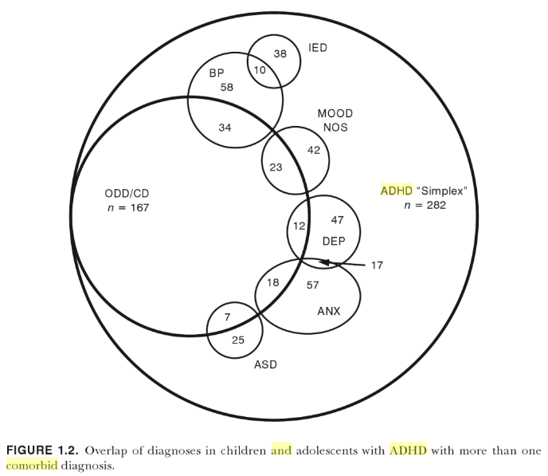
Definitions
5-10% prevalence
5-10% prevalence
2.5-5% prevalence
50%
50%
25-50%
50%
50%

Slide 8
Co-Morbidity: Trauma
Co-morbidity: It is not surprising that these two areas are being evaluated, as cognitive and emotional disruptions that occur in response to trauma, such as difficulty concentrating, dysregulated affect, irritability, and hyperarousal, either overlap with ADHD symptomatology or exasperate it.
Before diagnosis there should always be a screen for trauma or even after diagnosing ADHD. They can co-occur or they may simply share some symptoms and seem like ADHD at times.

Slide 9
Co-Morbidity: Brain injury
Co-morbidity: A meta-analysis found a significant association between ADHD and mild Traumatic Brain Injury (mTBI), which was significant when limited to studies that reported on ADHD subsequent to mTBI and when the direction of the association was not specified, but not for studies that reported mTBI subsequent to ADHD.
mTBI has an impact on the brain that is associated with having ADHD symptoms for both adults and children.

Slide 10
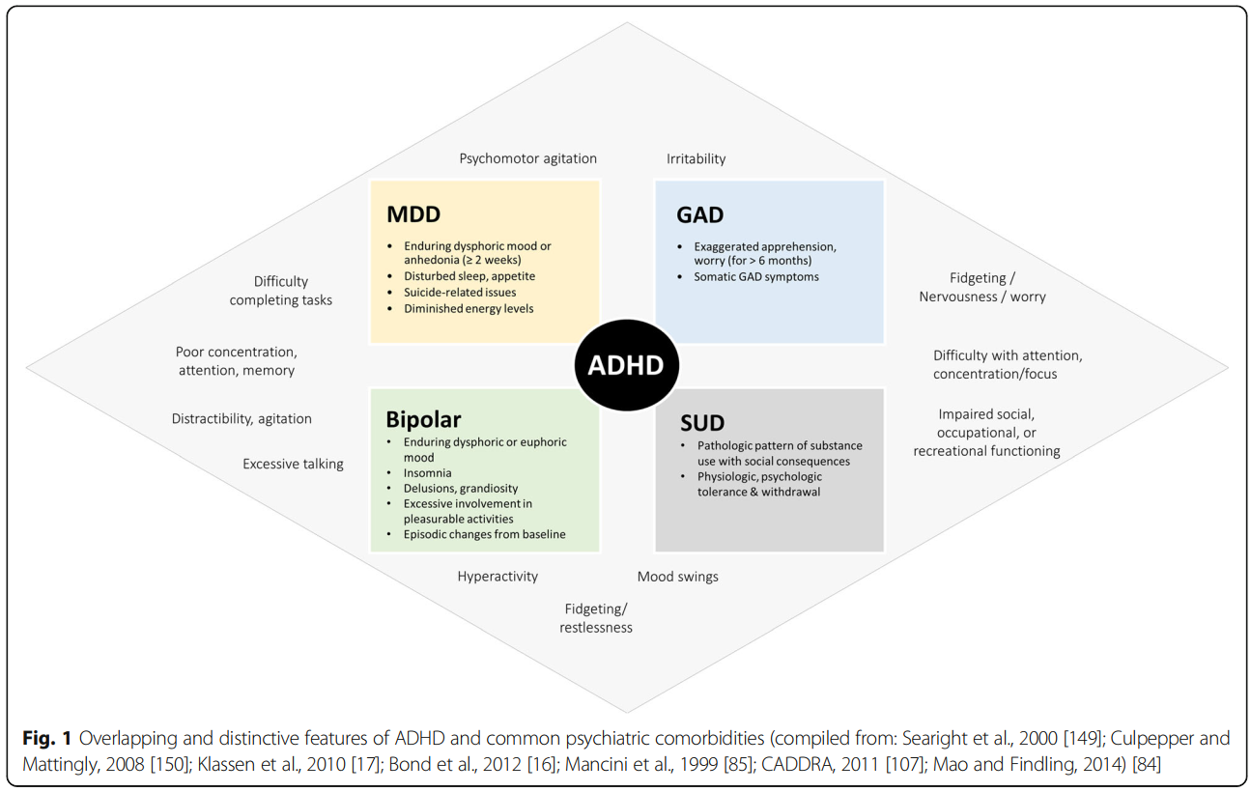
Definitions
For adults:

Slide 11
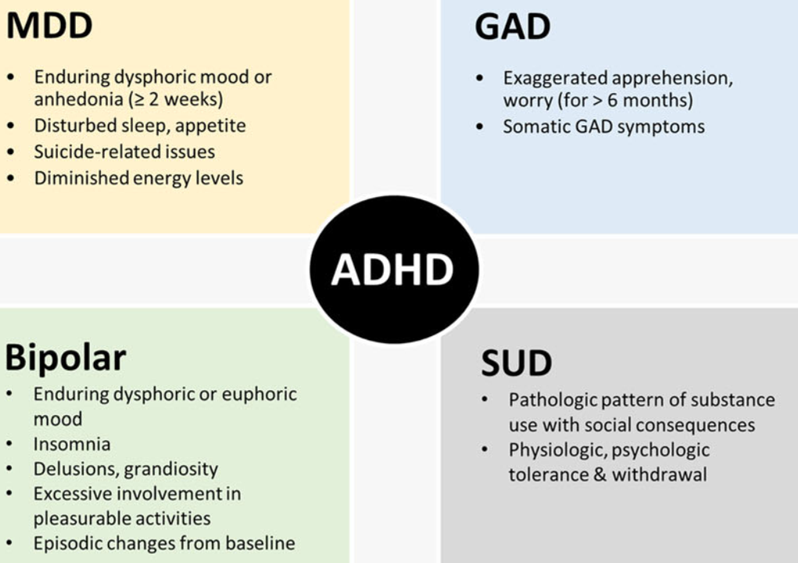
Definitions

Slide 12
Inattention or depression or Anxiety?
Anxiety, Depression, ADHD, and rumination
ACTIVITY:
Can you identify which symptoms are ADHD and which are Major Depressive Disorder (MDD) and/or Generalized Anxiety Disorder (GAD)

Slide 13
Inattention or depression or Anxiety?
Loses focus easily
“Chaining” thoughts or daydreaming. Going ‘blank’
Seems as though information/instructions does get encoded “In one ear and out the other.”
“Difficulty” with time management, losing track of time.
May have multiple tasks going at the same time but not functioning in any of them.
“Difficulty” in management in their belongings or materials.
Routines are difficult to enact without ‘attention grabbing’ assistance.
Can be very focused on their own thoughts or plans to the point that other’s get ‘drowned out’
Diminished ability to think or concentrate, indecisiveness.
Can have difficulty understanding consequences for actions or reasons for a punishment.
Diminished interest or pleasure in activities.
Difficulty concentrating or mind going blank.
Sleep disturbance (difficulty falling asleep.)
ODD or CD
MDD:
MDD:
ALL 3:
GAD:

Slide 14
Co-Morbidity and Substance use/abuse (SUD)
Co-Morbidity: children with ADHD were at least 1.5 times more likely to develop substance use disorder (SUD) across diverse forms of substances, including nearly 3 times higher for nicotine dependence. Considered together, our results suggest that early ADHD strongly predicts future substance abuse/dependence in adolescence/adulthood and that this association is largely unaffected by demographic and methodological factors that varies across studies.
Other studies have show that those with ADHD may smoke sooner than the population average and be at a higher risk of risky substance use in college including binge drinking.

Slide 15
Differential Diagnosis
Differential Diagnosis:
Oppositional Defiant Disorder (ODD): They may not seem to listen or may have difficulty when spoken to. They may avoid tasks that require mental effort. They may quickly seem to forget what they were tasked with because they “don’t seem to care” not because of inability. The underlining piece is defiance, negativity, and hostility rather than hyperactivity or impulsiveness. These can look very mixed at times because, “Why should I try if I know I’m not going to end up doing it right anyway.”
Intermittent Explosive Disorder: both have high impulse behaviors except there is more “serious” aggression and can sustain attention.
Reactive Attachment Disorder: May show lack of attention or affection or social disinhibition. Can look like they are impulsive but may simply not feel that social rewards/motivators are worth efforts for meeting expectations.

Slide 16
Discussion #2
Susan is a 36 year old female, currently living at home with her husband of 11 years and two young children, ages 2 and 4. She recently resumed working after taking four years off after the birth of her first child. Susan is experiencing increased levels of stress as she tries to balance the challenges of parenting with the academic demands of her career as a dietician. Susan reports a longstanding history with poor attention. She was identified in grade school as requiring special accommodations and support from her teachers, but was never diagnosed with a confirmed learning disability. She used ear plugs when studying in school. Her difficulties with focusing and time management have continued into adulthood, affecting her ability to effectively manage her finances and to balance her work/family time relationship. She has been able to cope by creating “pressure” to engage her focus, but this has resulted in symptoms of anxiety, depression, feelings of guilt, and loss of self-esteem. Susan worries that by focusing her energies on managing her work responsibilities, she is neglecting other areas of her life, particularly her children. Susan is concerned with perceived underachievement and inefficiency at her place of employment. She struggles with procrastination, and has difficulty with organization. Due to the increased demands and responsibilities she now faces in the home, Susan finds that she is not able to focus on work-related duties the way she used to. As a result, she has been disappointed by her recent performance at her place of work. Susan is an intelligent and engaging communicator, but she feels overwhelmed by her current responsibilities and worries that she is not performing to her real potential. She sometimes feel paralyzed by stress, and reacts by retreating into herself rather than by asking for help. She says that she needs a “life GPS" to function. Recent stresses include her stepfather and her cat are both severely ill. She has been on an anti-depressant for 8 years from her psychiatrist. She often is completing many tasks at home at the same time but maybe forgetful such as leaving wet laundry in the washer for several days. She is challenged to stay focused to even read a book.

Slide 17
Discussion #2
Jack is a 7 year old male Grade 1 student who lives in Toronto with his parents. He is the only child to two parents, both of whom have completed post-graduate education. There is an extended family history of Attention Deficit/Hyperactivity Disorder (ADHD), mental health concerns as well as academic excellence. Jack is an intelligent and caring young boy who presents with significant potential to excel academically. In his spare time, Jack enjoys spending time with his friends, and participating in physical activities such as swimming, running and skating. He also enjoys participating in social events, and is often invited to play dates and birthday parties. It is noteworthy that he did not know his address or home phone number, could not print his surname, and recognized only a few pre-primer words. While Jack interacts well with peers his own age, his parents note that he can be easily led and influenced by others. They also report that Jack gets upset when he does not receive recognition or feels that he has been ignored. His teacher notes that he sometimes acts 'socially immature', and that he often demonstrates attention-seeking behavior. Jack describes difficulties with focusing, and sitting still in class. He recognizes that he is able to 'hyper focus' on some activities of interest, however he often has difficulty sustaining his attention at school. His parents and teacher indicate that Jack is restless, and often requires reminders to help him stay on task. He is described as "constantly running around" and presenting with difficulties listening and following instructions. Jack's teacher indicates that he often blurts out answers and interrupts other students in the classroom. Jack recognizes this tendency in himself, but says that he 'can't stop' in spite of his best intentions. Jack has always had challenges falling asleep, and sometimes finds that he wakes up in the middle of the night. When he wakes up he finds that he has a difficult time getting back to sleep - sometimes staying awake for as long as an hour and a half. His mother reports difficulties at home with following routines and remembering instructions. His parents describe emotional reactivity as well as confrontational behaviors demonstrated both at home and at school. His teacher notes that Jack is very defiant towards listening to instructions, but generally interacts well with his peers. He is easily frustrated and emotionally impulsive - Jack has had several incidents of hitting, crying outbursts, and inappropriate behavior. Behavioral concerns with aggression, lying, arguments, and disruptive behavior were noted in pre-school program at age 4.

Slide 18
The take away
ADHD frequently co-occurs with another disorder or the symptoms might be from another disorder entirely. The anxiety and depression symptoms seem to create further difficulty in functioning and may create a downward or upward “spiral” of symptoms.

