Slide 1
Understanding Relationships Scientifically and Helping with Pattern Recognition
Healthy Relationships and Relationship Styles

Slide 2
Thinking about the problem
Every relationship is different because every person is different. No relationship is perfect because no person is perfect. (There is no such thing as Mr. or Ms. Perfect)
So what is a ‘healthy relationship’?
Much of how we define relationships in psychology is by how people solve their problems.

Slide 3
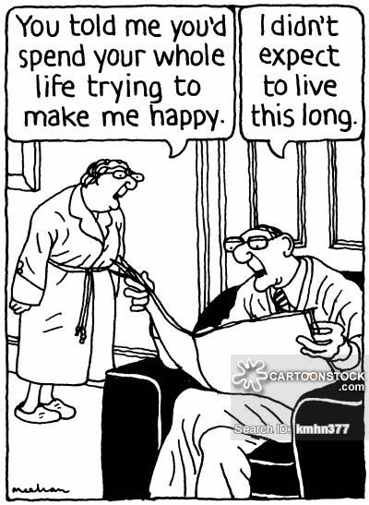
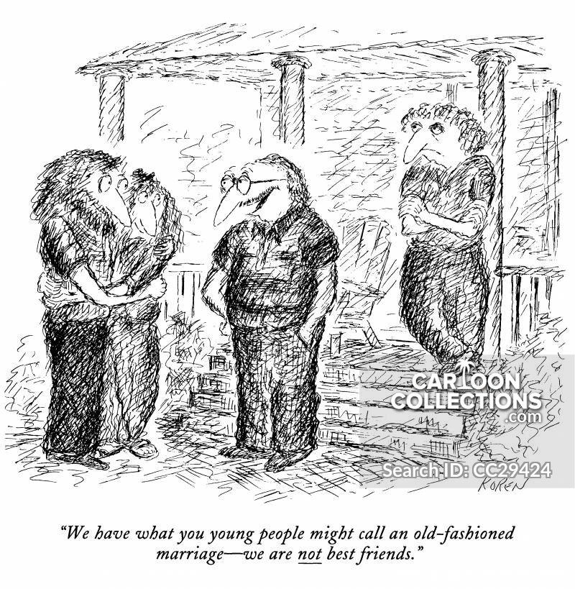
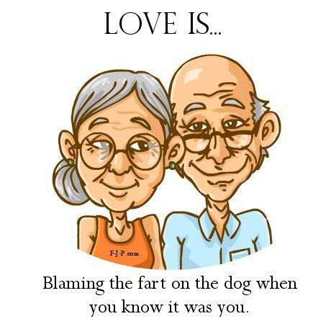
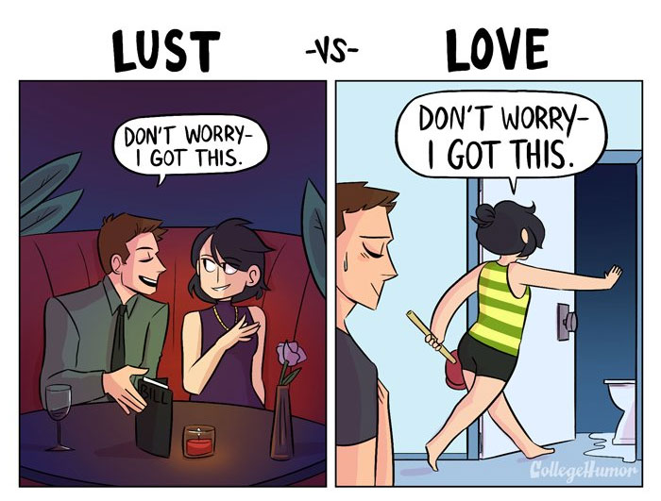
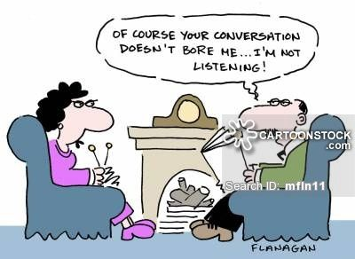
Understanding relationship styles

Slide 4
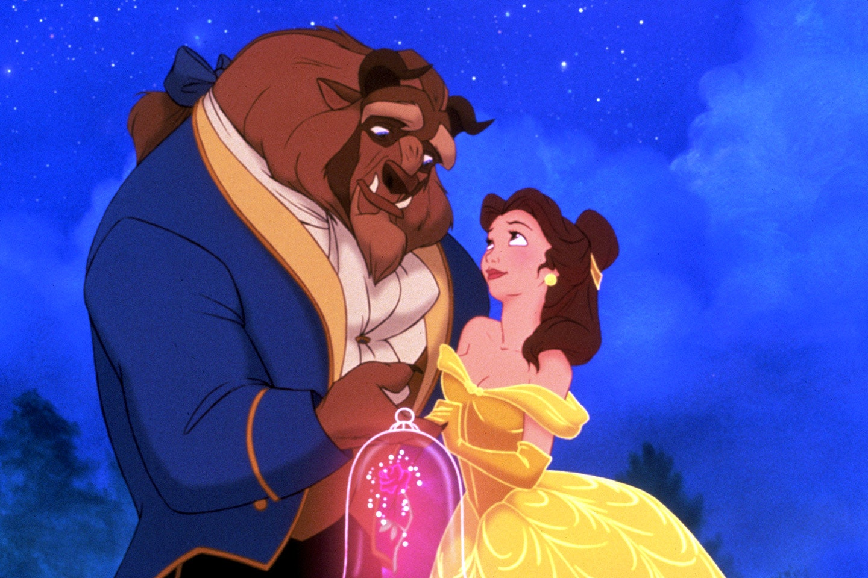
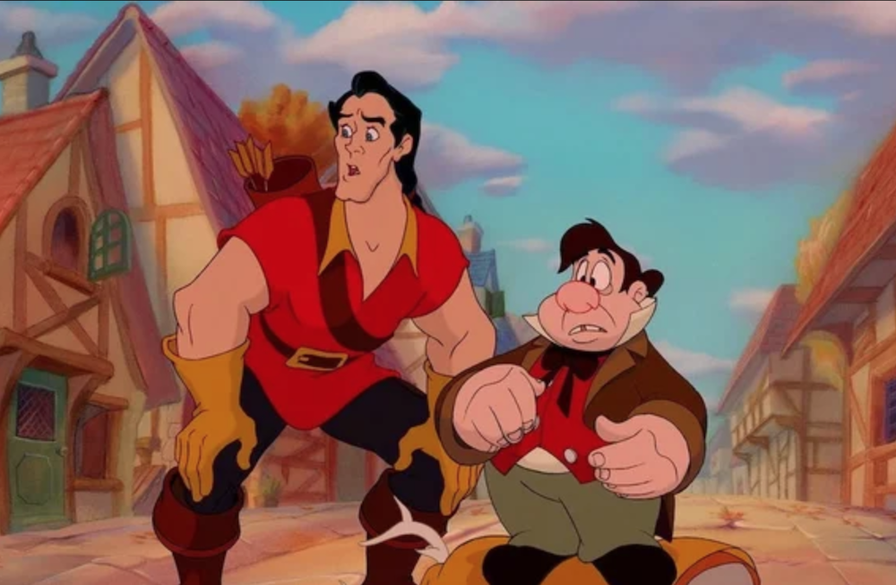
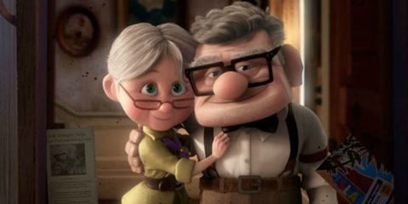
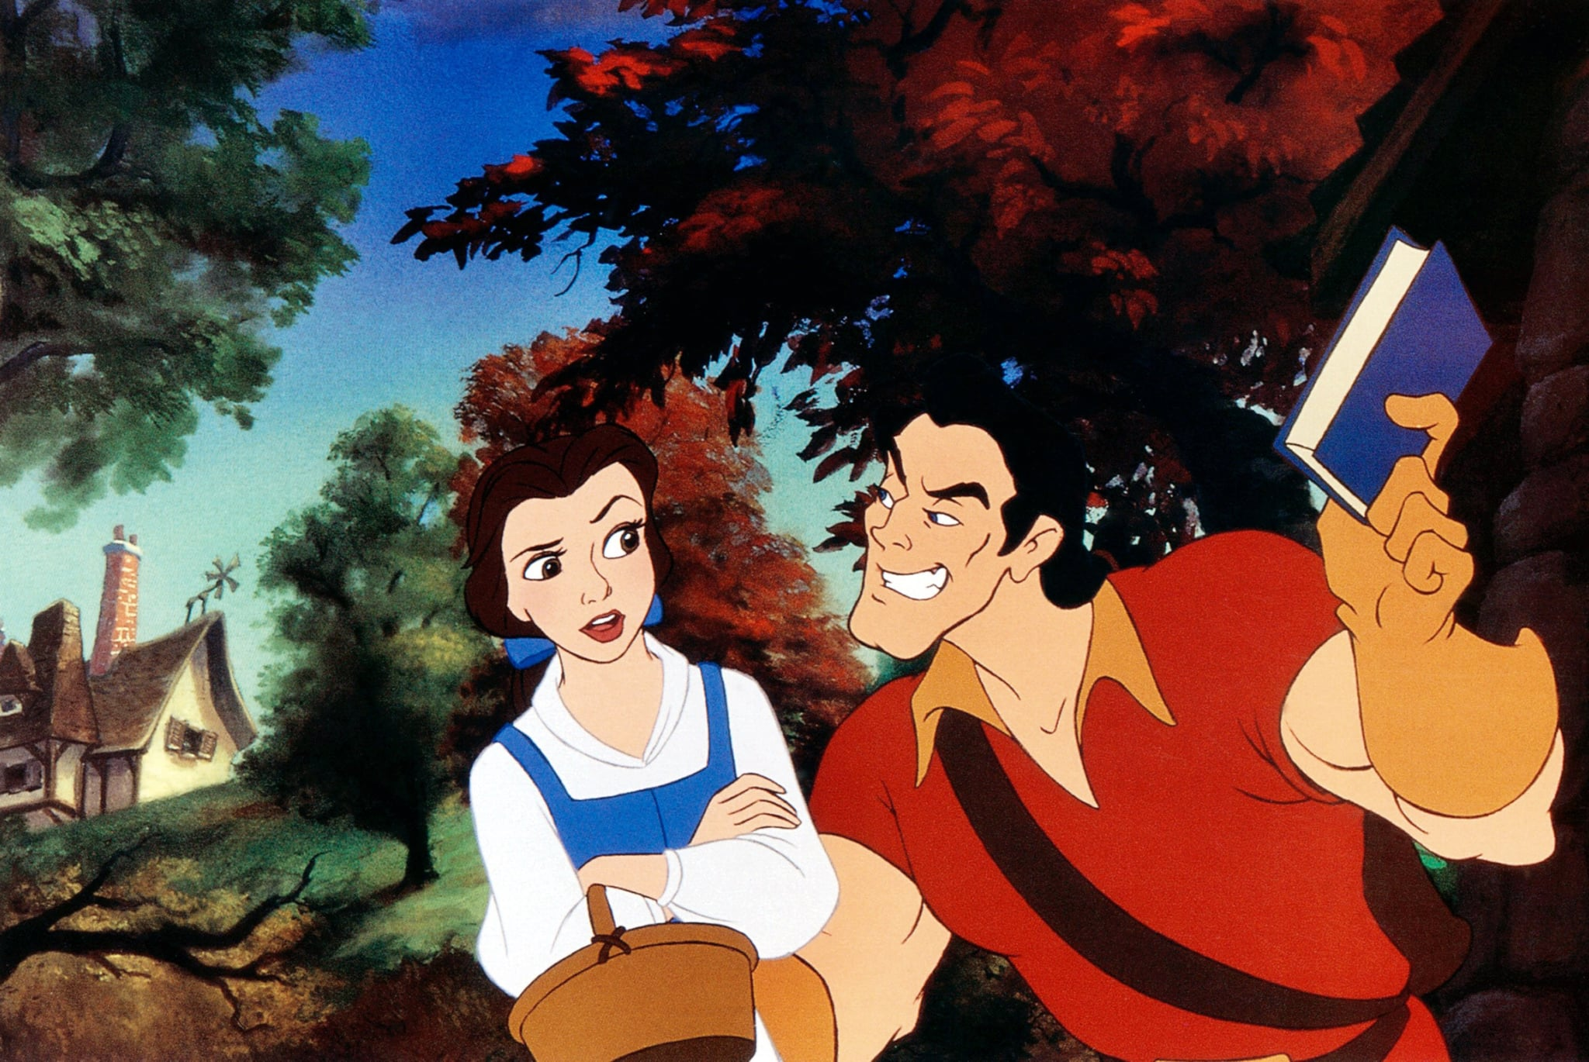
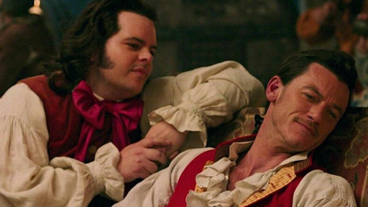
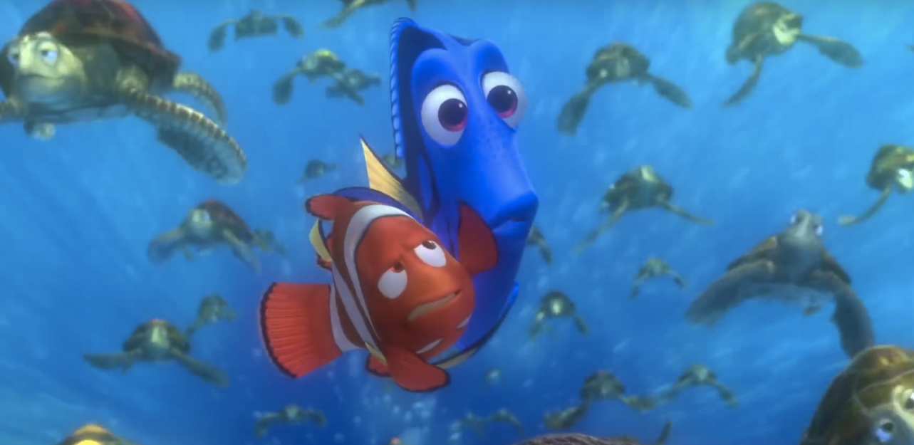
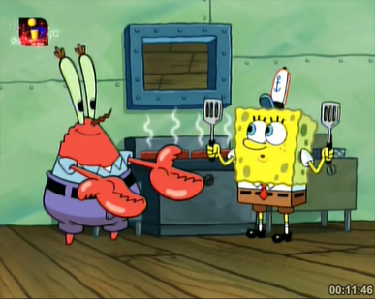
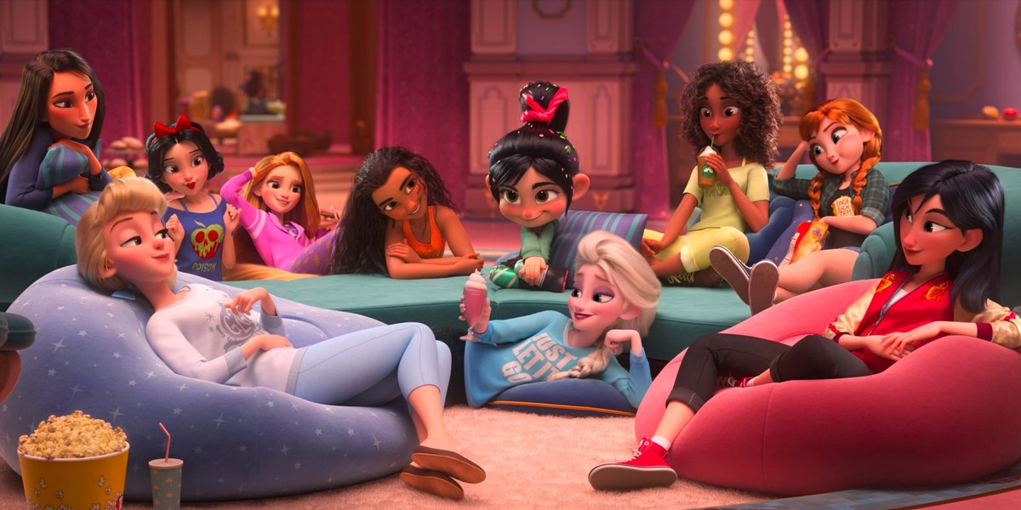
Understanding relationship styles
New York City Pizza Rat

Slide 5
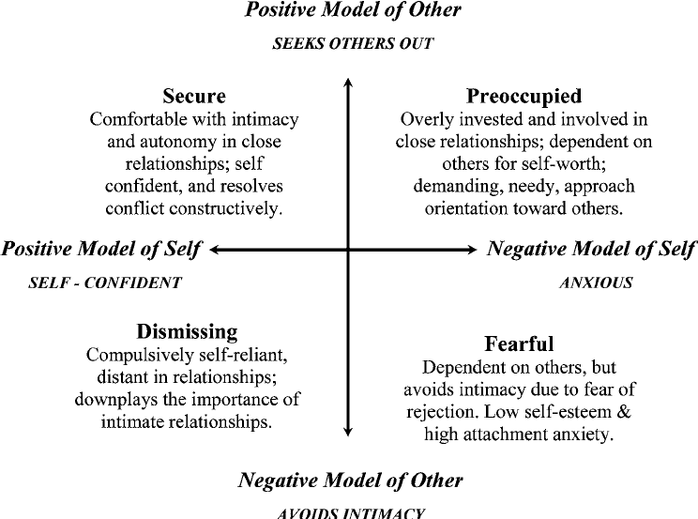
Understanding relationship styles
Sometimes called ambivalent

Slide 6
Understanding relationship styles
Beyond roles, what are the rules for a relationship?
Can a neighbor borrow your tools?
Can a friend borrow money or crash on your couch for a few days? A few months? More?
Do you share a bank account with your spouse? Your fiancée? Your significant other?
Do you share phones or use each other’s phone(s) or car(s)?
Can your S/O spend time with their best friend without checking in? Spend the night? Go on a trip together and share a room? Share a bed? Hold hands? Kiss on the cheek? Do each other’s hair? Snuggle under a blanket together? Would it matter what the gender of their best friend is? Why?
Can they call your outfit ugly if they’re being honest? Can they tell you that your weight is getting to be unattractive (too thin or too heavy?)
eros (romantic, passionate love),
ludus (game-playing love), and
storge (friendship love);
three secondary styles (seen as compounds of the primaries): mania (possessive, dependent love),
pragma (logical, "shopping-list" love), and agape (selfless, all-giving love)

Slide 7
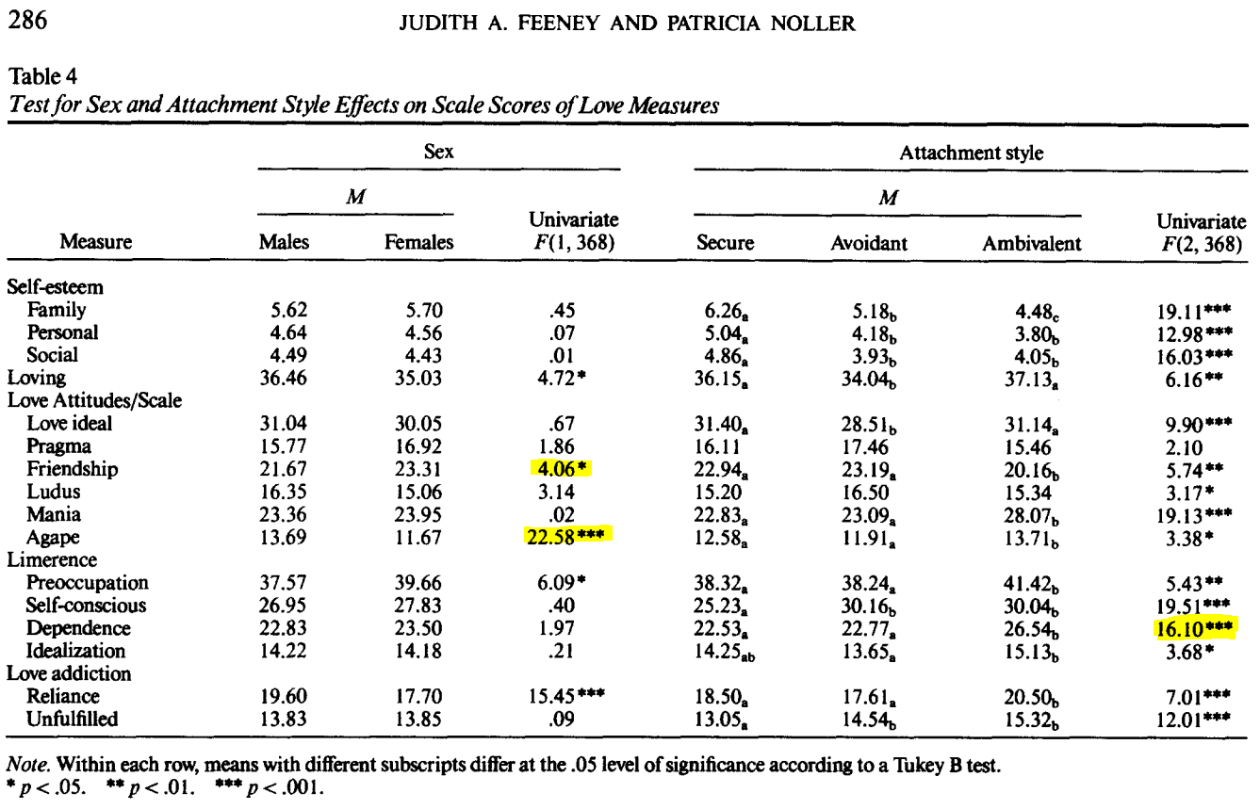
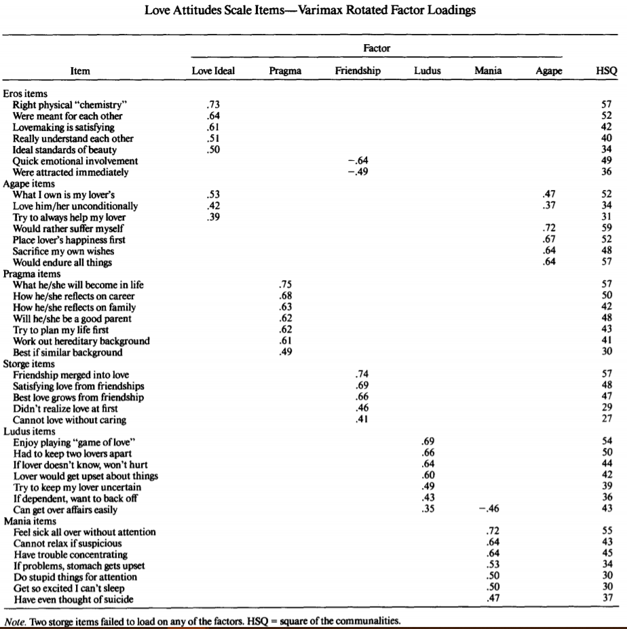
Understanding relationship styles
The probability that attachment style and love attitudes are not related in areas all areas but Pragma are very low.
Scales/Screeners can help with understanding the different parts to a relationship such as conflict resolution, common goals, or communication patterns as seen in this 1990 study.
https://fetzer.org/sites/default/files/images/stories/pdf/selfmeasures/Different_Types_of_Love_LOVE_ATTITUDES.pdf
https://www.psytoolkit.org/cgi-bin/3.1.0/survey?s=saJze

Slide 8
Understanding relationship styles
Codependency refers to enabling and controlling behaviors, poor boundaries, lack of self-care, and focusing on other’s needs instead of one’s own needs. And while the teaching of codependency can be immensely helpful in dealing with individuals who have a chronic pattern of these traits, labeling every partner of an addict as “codependent” is damaging. It implies that there is something wrong with the codependent person because they have been impacted by a person struggling with addiction. Experiencing trauma reactions such as hypervigilance, increased anxiety and depression, re-experiencing the event, emotional numbing, need to control, irritability, etc. as a result of a loved one’s addiction and behavior is not codependency.

Slide 9
Understanding relationship styles
In his book, “Transcending Post-Infidelity Stress Disorder” Dennis Ortman, Ph.D. explains how these symptoms are normal reactions to an extraordinary event, a discovery of partner’s lies and betrayal. He further explains that the word trauma means “wound,” and the betrayed partner has been wounded to the core of his/her being by their partner’s betrayal of trust.
Sadly, partners of individuals struggling with substance or behavioral addictions often get assigned the label “codependent.” Sometimes the hypervigilance and controlling behaviors of the partner are related more to re-experiencing traumatic feelings triggered by memories from the effects of their partner’s addiction. Therapy should always be trauma-informed. Instead of labeling someone “codependent,” it’s important to recognize that these are normal reactions to trauma and not psychopathology.

Slide 10
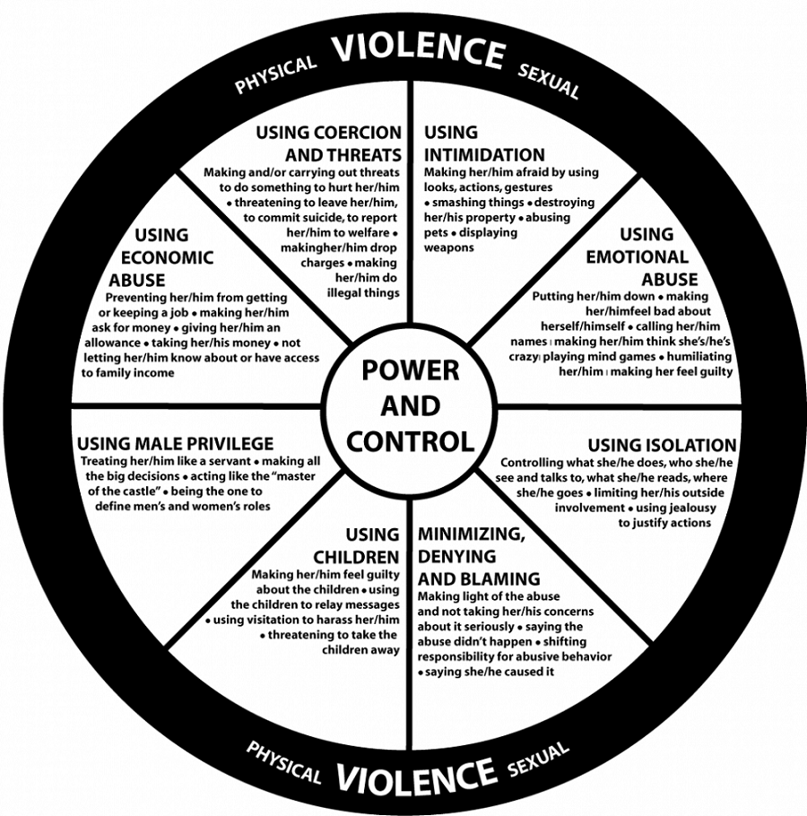
Wheel of Power and Control (Wheel of Domestic Violence)
Understanding the dynamic between emotional interdependence, drive for emotional intimacy/closeness, and space/time and activities apart.

Slide 11
Wheel of Power and Control
Forms of Abusing Power and Control in Domestic Settings:
Physical Abuse: Any attempt to hurt or scare your partner by physically hitting, cutting, shooting, pushing, touching, burning, or any activity resulting in internal or external harm.
Abuse of Privilege: Treating your partner like a servant. Deciding by yourself who has final say in decisions about money, free time, your partner’s friends, activities, and work. Being the “master of the castle.” Defining men’s and women’s roles.
Abuse by isolation and Restriction of Freedoms: Controlling and limiting what your partner does, who they are allowed to see, or limiting outside involvement using jealousy or guilt to justify actions.
Emotional Abuse: Attempts to put your partner down, making them feel bad about themselves, name calling, playing mind games, humiliating them, or making them feel guilty. Tearing down your partner’s self-confidence, personal image, or emotional memories.
Intellectual Abuse: Limiting your partner to specific forms of information, philosophies, beliefs, values, or morals. Regarding a partner to accept your point of view. Not allowing a partner freedom of expression.
Abuse by Minimizing, Denying, and Blaming: Making light of the abuse and not taking complaints about it seriously, saying the abuse didn’t happen, shifting responsibility, or saying the other person caused it. Blaming your partner for life’s troubles
Understanding the dynamic between emotional interdependence, drive for emotional intimacy/closeness, and space/time and activities apart.

Slide 12
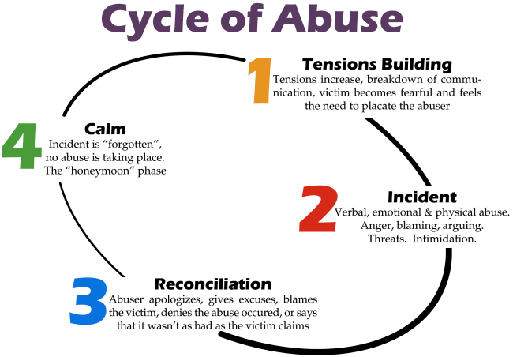
Cycle of Abuse
Understanding the dynamic between emotional interdependence, drive for emotional intimacy/closeness, and space/time and activities apart.

Slide 13
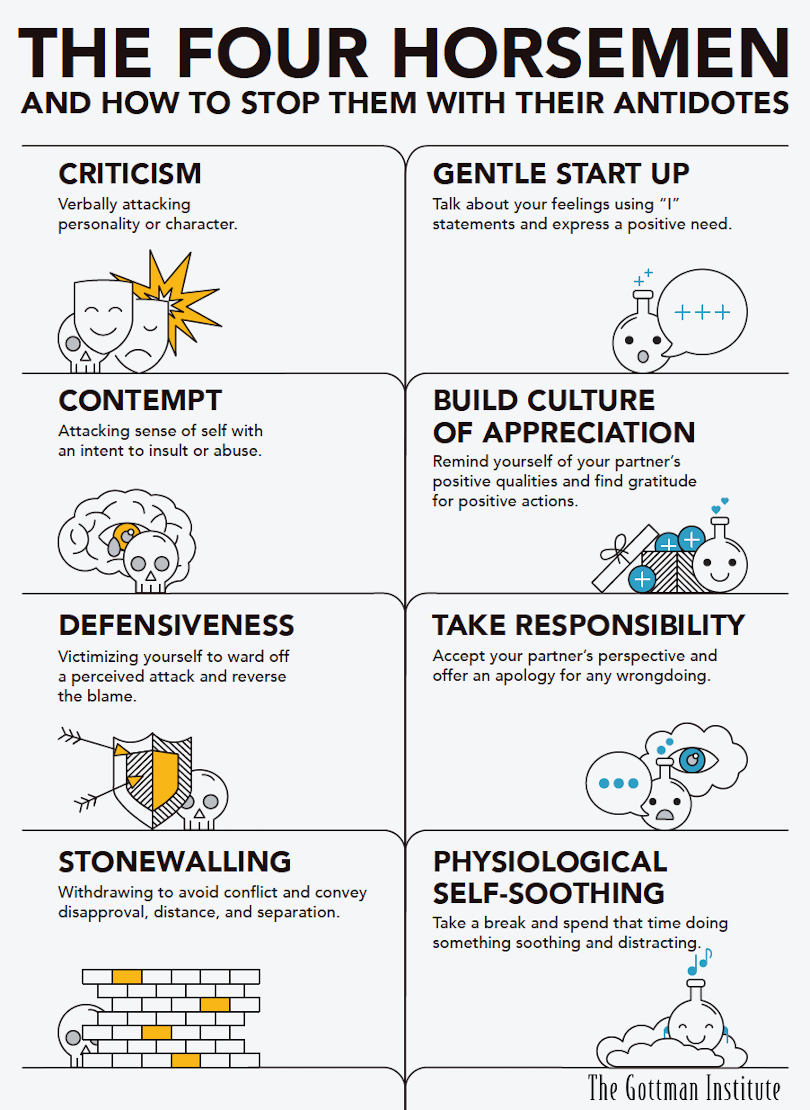
The Four Horsemen of poor relationships
“Keeping Score” in Relationships rather than caring.
Understanding the dynamic between emotional interdependence, drive for emotional intimacy/closeness, and space/time and activities apart.

Slide 14
Love attitudes and patterns
“With regards to Storge, this love style was positively associated with psychological aggression received. This result is in line with previous studies indicating that Storge love style is commonly found in the context of partner violence (Lucariello, 2012). Further, our findings may be related to the fact that these individuals consider falling in love to be more romantic in nature and a long-term commitment (Galicia et al., 2013). In turn, the romantic love model and acceptance of associated myths play a crucial role in the onset and maintenance of violence (Ferrer et al., 2008). As noted above, the literature states that this myth of romantic love particularly affects women (Cantera & Blanch, 2010). This can be explained from the social and power structure that urges women to seek a partner under the pretext of seeking ideal love, condemning them to inequalities, subjugation, and sacrifice. In this way, a model of domesticity is constructed where family, and by extension home, is the naturalized habitat of a woman, who lives situations of conflict generated from unreal equality guidelines that new generations have assumed under the protection of traditional roles, despite the evident persistence of gender differences (Melero, 2008). A search for romantic love is imposed on girls in order to organize and build a future, while for boys it is seduction, implying profit. The need to love is stronger in women, but at the same time it is more dependent, as Leal (2007) points out.” - Love attitudes and Violence: Consequences of Burden of Care on Women (2019) Diaz, Estevez, Momene, Ozerinjauregi.

Slide 15
Conflict, Problem Solving, and the Vagus Nerve
“They used a procedure in which they took very small quantities of blood from the couple as they discussed an area of conflict in a hospital setting. They could later measure the couples’ hormones and neurotransmitters in their blood in real time, as they argued. They then followed these newlyweds for 10 years. They found that those couples who eventually divorced, had—in their first year of marriage during the conflict discussion; that’s 10 years prior—secreted 34% more adrenaline during the conflict, 22% more adrenaline during the day, and 16% more adrenaline at night than the couples who remained married. Comparing the happy couples with those they called “the troubled,” they found that compared to the eventually happy couples, the ones who turned out 10 years later to be troubled had secreted 34% more adrenaline during the conflict, 24% more adrenaline during the day, and 17% more adrenaline at night. Note that they were predicting the fate of these newlywed couples 10 years later, just by measuring adrenaline and noradrenaline in their blood during the first year of marriage” - The Natural Principles of Love Gottman (2017) Journal of Family Theory and Review.

Slide 16
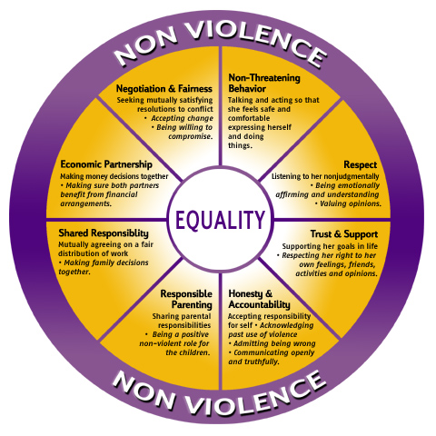
Wheel of Equality
Understanding the dynamic between emotional interdependence, drive for emotional intimacy/closeness, and space/time and activities apart.

Slide 17
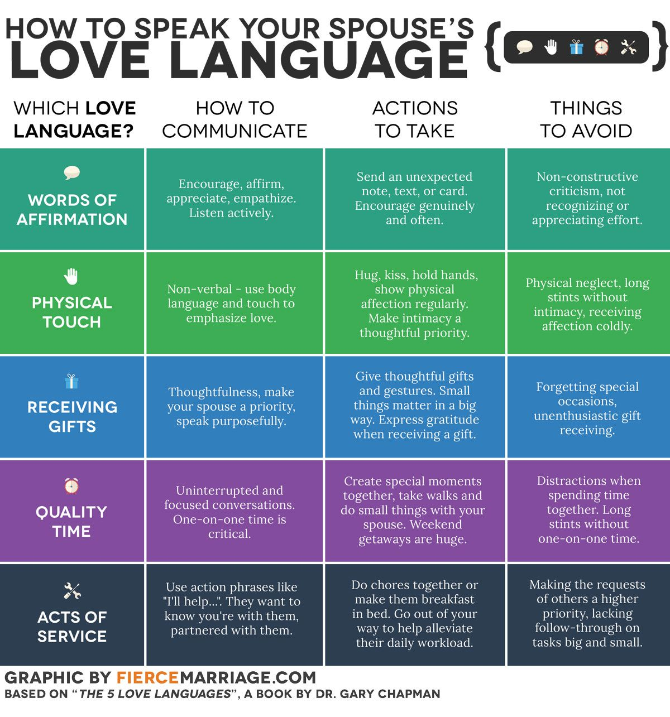
Love Languages and Drives
Understanding the dynamic between emotional interdependence, drive for emotional intimacy/closeness, and space/time and activities apart.

Slide 18
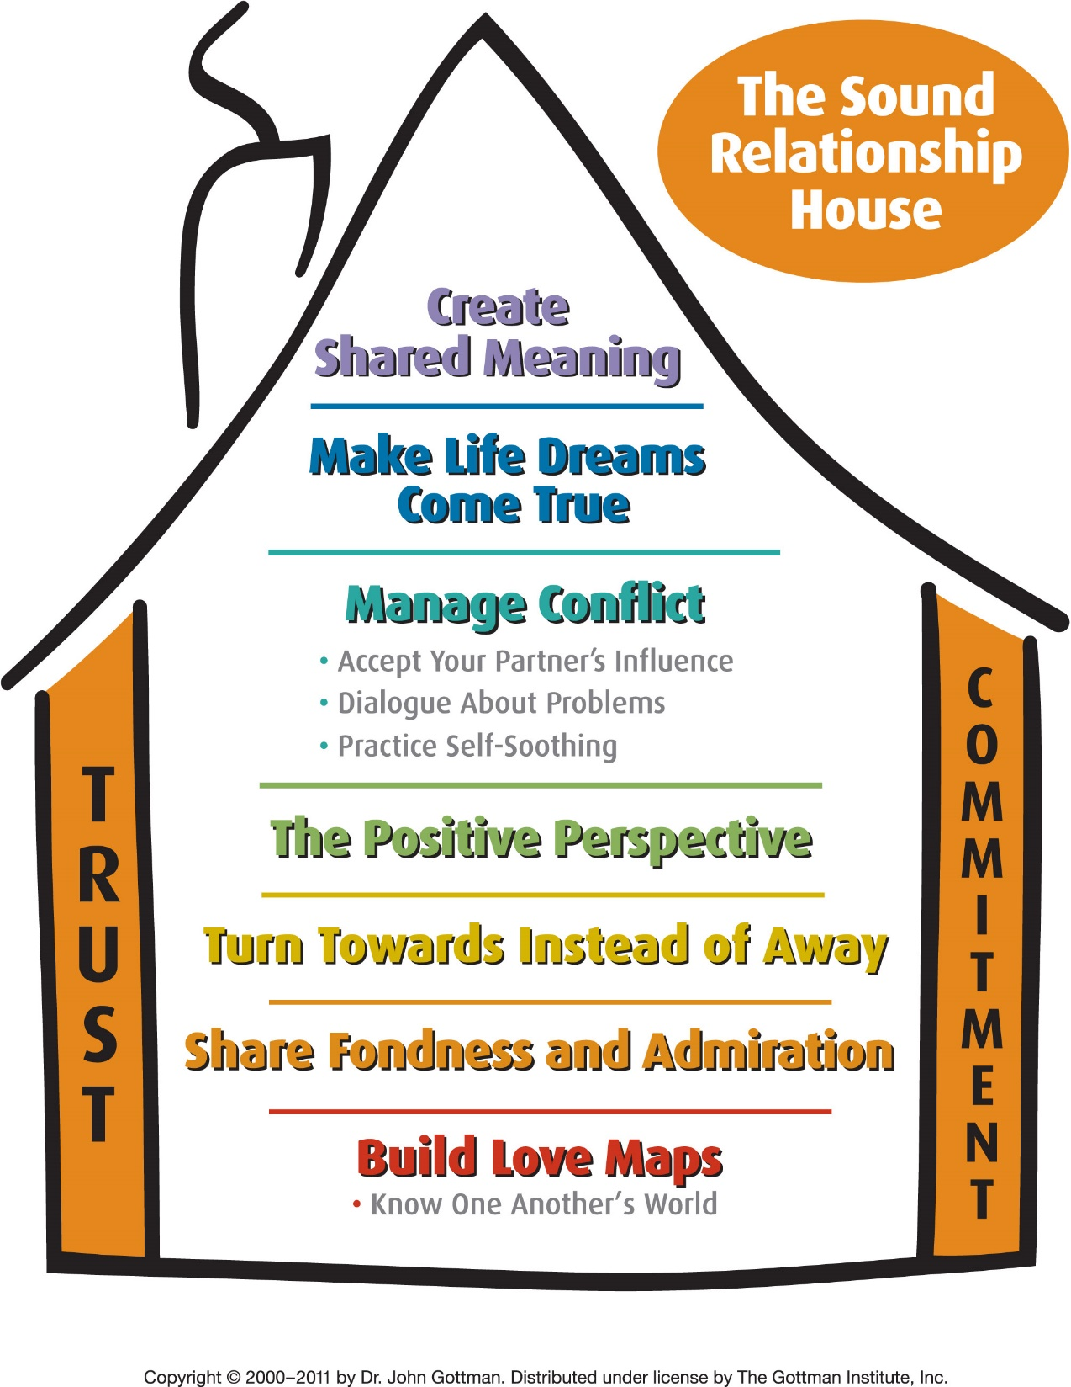
The sound relationship house
Understanding the dynamic between emotional interdependence, drive for emotional intimacy/closeness, and space/time and activities apart.

Slide 19
What is Love?
Taking actions to care to improve one person’s happiness or wellbeing even more than your own.
And it is reciprocated: the other person cares about your happiness and wellbeing even more then their own.
What is the difference between love and a business contract?
Do you have to love yourself in order to love someone else?
Discussion: Can a person really be your “everything”?
Is there such a thing as true love or that a relationship can “complete me”?
https://www.youtube.com/watch?v=ON4iy8hq2hM TED TALK 13 minutes: The difference between healthy and unhealthy love | Katie Hood

Slide 20
Understanding relationship styles: Family
https://www.youtube.com/watch?v=bG9MvUozHZ0&feature=emb_logo
Family First Intervention 2.5 minutes The Four building blocks of an Enabling Family System:
Guilt: blaming others for their problems because of addiction
Hope: If you just do this I will quit, I promise this will be it and things will be better.
Fear: If you do this, I’ll do that and it will be your fault.
Victim: If you had this life, if you were like me, you would use to. This is a reasonable way to act.
https://www.youtube.com/watch?v=UDpcNvzg324 7 minutes. What are the signs of Codependency, How codependency impacts families with addiction. Family First Intervention.

Slide 21
Understanding relationship styles: Family
The Enabler – The Enabler is a family member who steps in and protects the alcoholic/addict from the consequences of his or her behavior. The motivation for this may not be just to protect the alcoholic/addict, but to prevent embarrassment, reduce anxiety, avoid conflict or maintain some control over a difficult situation. The Enabler may try to clean up the messes caused by the alcoholic/addict and make excuses for him or her, thus minimizing the consequences of addiction.
The Hero – The Hero is a family member who attempts to draw attention away from the alcoholic/addict by excelling, performing well and generally being “too good to be true.” The Hero has a hope that somehow his or her behavior will help the alcoholic/addict to stop using. Additionally, the Hero’s performance-based behavior helps to block emotional pain and disappointment.
The Scapegoat – The Scapegoat is a family member who creates other problems and concerns in order to deflect attention away from the real issue. This can be through misbehavior, bad grades or his/her own substance use. Oftentimes, the Scapegoat is very successful at distracting the family and others from the addicted individual.
The Lost Child – The Lost Child is a family member who appears to be ignoring the problem completely. There could be a fight, with yelling and screaming, and the Lost Child will be absent or secluded from the situation. They are often perceived as the “good” child because much time is spent alone with books or involved in isolated activities. While the Lost Child will not be successful at drawing attention away from the family problem, he or she is able to avoid stress personally.
The Mascot – The Mascot attempts to use humor as a means to escape from the pain of the problems caused by addiction. He or she will often act out by “clowning around,” cracking jokes or making light of serious situations. While the Mascot can certainly help lighten up a desperate situation, the real intent is to ease tension, keep the peace and serve as a distraction. Many comedians come from dysfunctional homes.

Slide 22
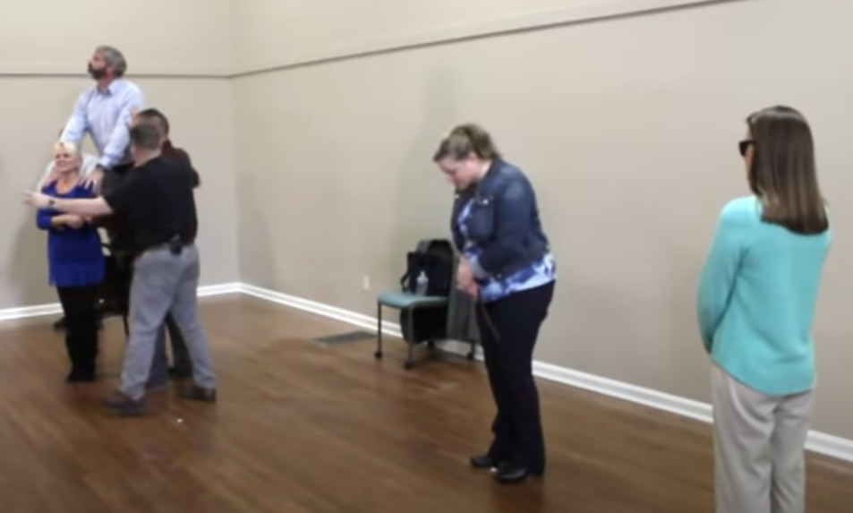
Understanding relationship styles: Family
https://youtu.be/NU12U3m7wXo?t=666 11:00 to 41:00 (30 minutes) Understand Family Roles:
Addicts and the roles their family plays- Cornerstone of recovery

Slide 23
The takeaway:
In our society, codependency is as deceptive as addiction. It often hides behind “doing the right thing,” obeying God, taking one for the team, and coming to the rescue of others. Though it looks benevolent, codependency serves the giver more than the receiver. Those who suffer from it use other’s dependence and approval as a means to feel loved without risking the disclosure of their own needs and doing that which is truly best for them. Like addiction, codependency is a way of coping with our true feelings by avoiding them and managing our external world. Drugs make the world a safe place for addicts and alcoholics; the neediness and approval of others make it safe for codependents. And it is a terrifying endeavor to reach out for help.
Unfortunately, it can seem unclear how to best help solve the problem, clean up the addict’s messes? attend a support group for themselves? Learn about family systems or addiction treatment?
If you are in a relationship with an addict or alcoholic, it is natural to experience codependency. It is tempting to believe that your efforts to help your loved one will influence them to stop using. This is simply not true because solving problems in relationships, especially addiction or anxious attachment, is more complicated than “just” giving them another try.

Slide 24
Control vs Caring: Discussion #2
Is calling someone “MY” boyfriend or “MY” girlfriend part of a culture of fostering Codependence? Why?
What is the difference between interdependence and co-dependence?

Slide 25
Understanding relationship styles: Further reading
https://www.gottman.com/blog/weekend-homework-assignment-taking-care-of-each-other-by-taking-care-of-ourselves/
https://www.marrinc.org/the-recovery-of-codependency/
https://www.gottman.com/blog/betrayal-trauma-in-addiction/
https://www.gottman.com/blog/intimacy-and-space/
https://www.gottman.com/blog/addiction-interview-robert-navarra/

